Slide 1
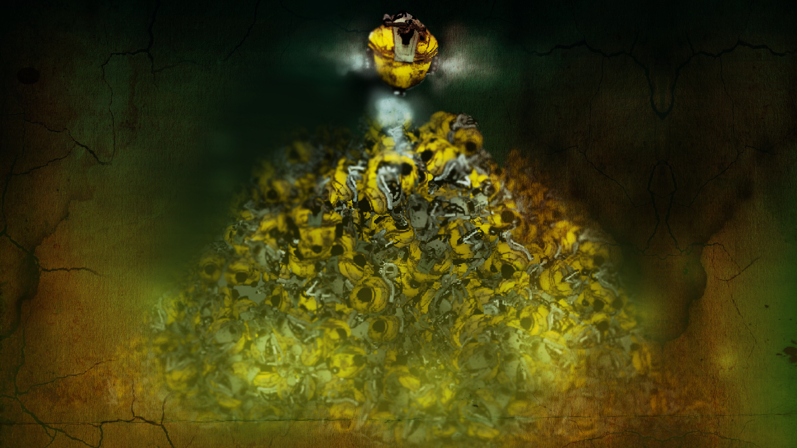
GEARFREED
Marijn, Kotryna, Bart, Anca, Vasil, Robin and Iris
Notes:
Introduction of the team and game name

Slide 2

THE GAME

Slide 3
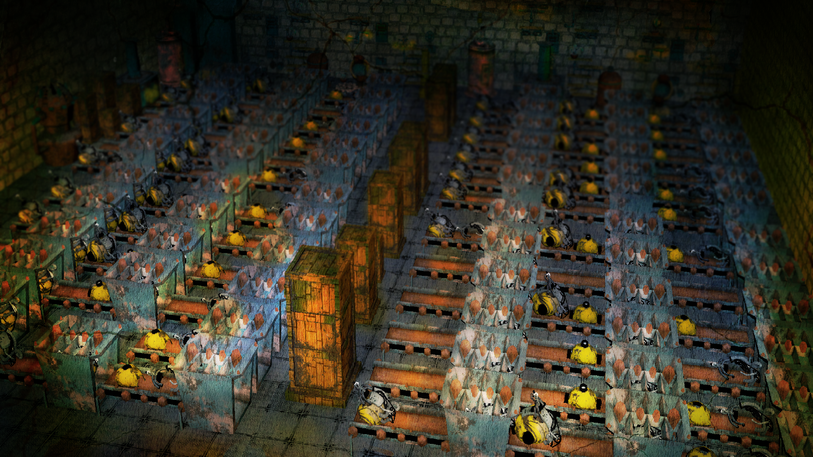
THE GAME
Notes:
Tell story, starting with robots being created for evil purposes

Slide 4
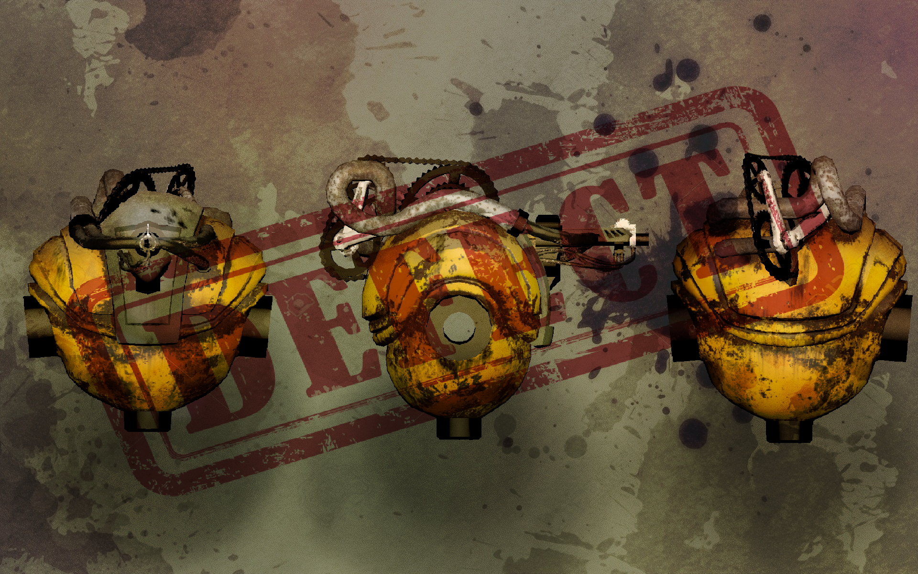
THE GAME
Notes:
There is a defect in the robots, because the robots have a consious. so all robots that are made are destroyes

Slide 5
THE GAME
Notes:
One robot survived, Gearfreed. He decides it is his mission to kill all Evil robots that are being built right now.

Slide 6
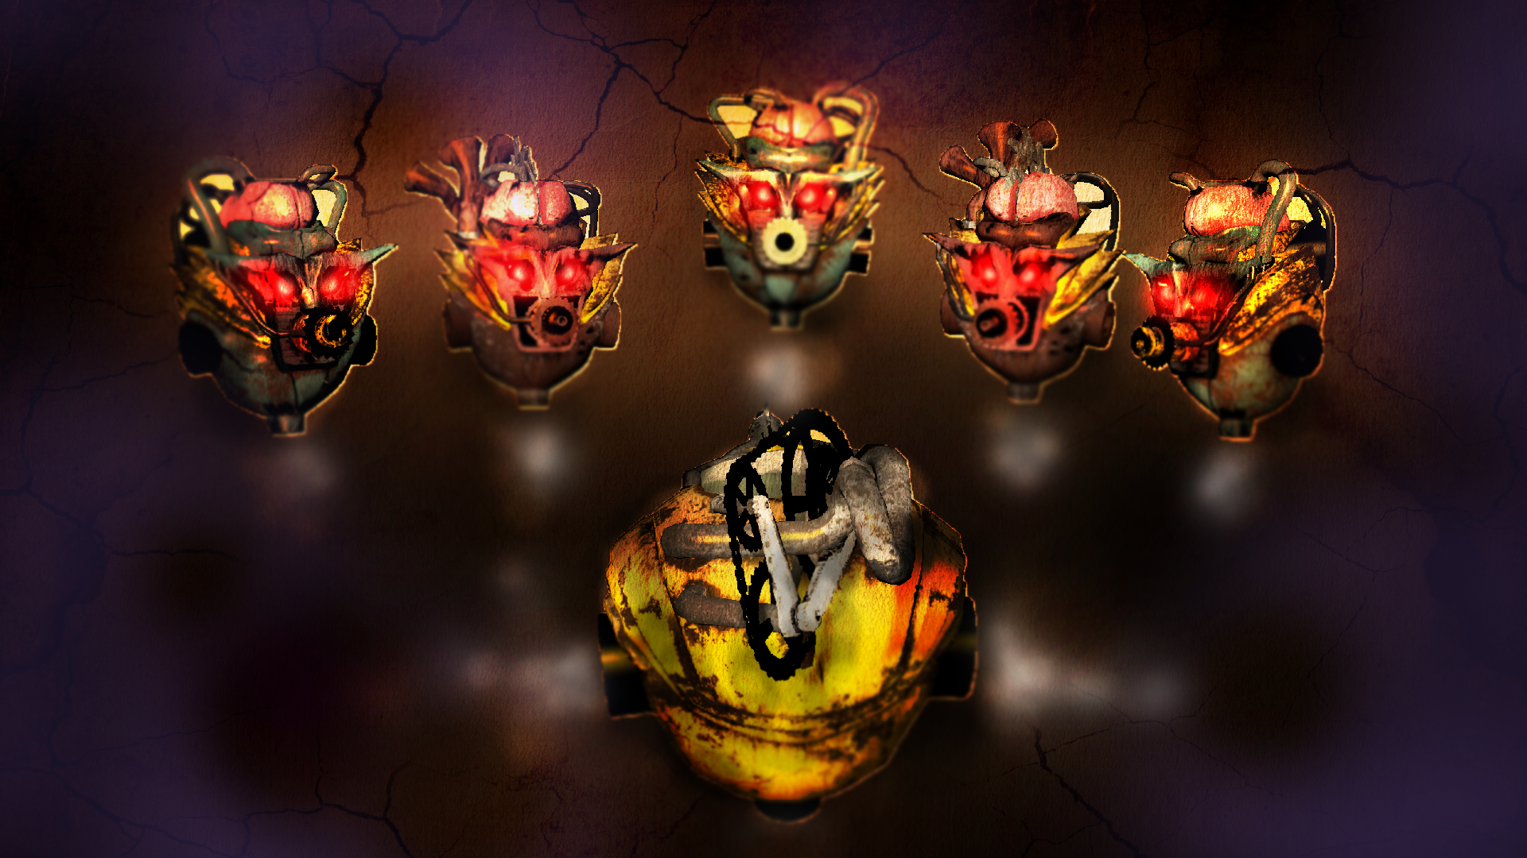
THE GAME
Notes:
He will rise up and fight against them

Slide 7
THE GAME
So when the good Gearfreed defeats the evil robots there is only one enemy left.
The evil inside
Notes:
But in the end it doesnt even matter. Eventhough all Evil robots were destroyed, Gearfreed felt the evil inside himself was growing. Because it was his duty to eliminate all evil, he prepared a bomb that killed him

Slide 8
THE GAME
But all hope is not lost!
Notes:
But all hope is not lost.

Slide 9
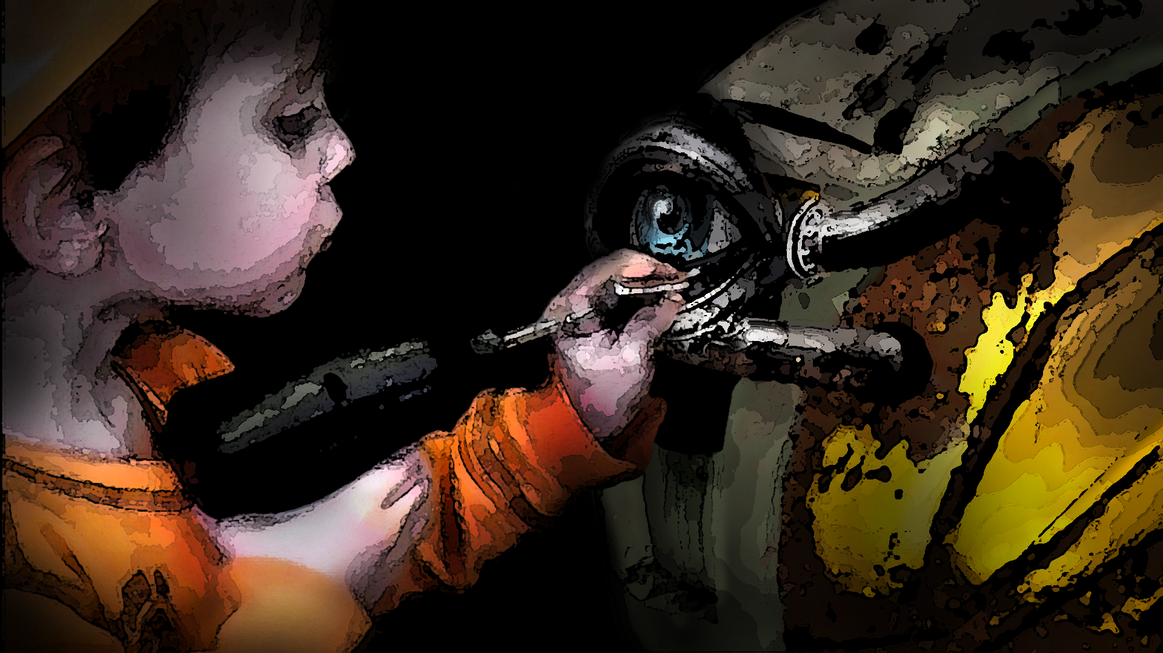
THE GAME
Notes:
Kids see the good in anything, and that is what this kid will rebuild. The good!

Slide 10
THE GAME
Code Marijn
Notes:
Marijn Code

Slide 11
THE GAME
Code Kotryna
Notes:
Kotryna Code

Slide 12
THE GAME
Code Bart
Notes:
Bart Code

Slide 13
THE GAME
Model View
Notes:
.exe vasil and robin made

Slide 14
THE GAME
Level hover over
Notes:
.exe vasil and robin made

